Slide 1
H0201280 Talk-to-Code: Coding by Dictation
By: Lam Zhen Zong Nicholas
Project Supervisor: Assoc Prof. Ooi Wei Tsang

Slide 2
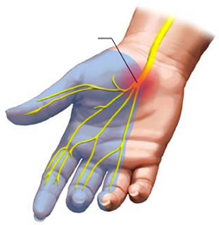
Objectives of the Project
Help people suffering from Carpal Tunnel Syndrome (CTS) to write code. [CTS is also known as Repetitive Strain Injury]
CTS – medical condition affecting median nerves of the hand
Programmers type code repeatedly for long hours.
Assist programmers to write code hands-free
This project allows users to write a program by voice
Notes:
[Credit] Dr. Vikas Sharma MD [https://www.drhomeo.com/orthopedic-problems/homeopathic-remedies-for-carpal-tunnel-syndrome/]

Slide 3
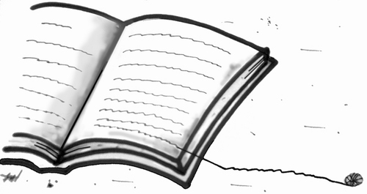
Literature Review
Two Approaches
Command based approach
Natural language based approach
Notes:
[Credit] Monica Zanet [https://www.toonpool.com/cartoons/Literature_115543]

Slide 4

Command Based Approach
VoiceCode.io (example)
By Ben Meyers, programmer suffering from CTS
Program where user use voice to control computer in real-time.
Emails, switch between applications, etc.
User’s speech in form of a command
E.g. “Doon twenty-one” → press down-arrow key 21 times.

Slide 5
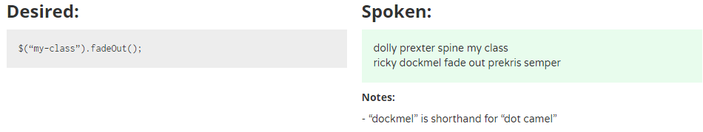
Command Based Approach
VoiceCode.io (example)
Example of spoken command for jQuery:

Slide 6
Command Based Approach
VoiceCode.io (example)
Strength: used for any programming language (because low-level building blocks used)
Limitations:
Steep learning curve (non-natural language words)
Lower productivity levels
Learning points:
Need more natural English words

Slide 7
Natural language based approach
Spoken Java (example)
By Andrew Begel and Susan L. Graham
Their motivation: help CTS programmers
Program where user use voice to code in natural way instead of typing.
They found that existing solutions not natural enough for programmers.

Slide 8
Natural language based approach
Begel’s research: Challenges with voice-based programming
Speech is ambiguous in nature
Homophones (same pronunciation, different spellings)
Sentences can sound like asking question or making statement
Stop words (“uh”, “um”, “erm”)

Slide 9
Natural language based approach
Begel’s research: Challenges with voice-based programming
Programming languages and tools were not meant to be ambiguous
They are designed to be read by computers (not humans)
Required to be precise, contain all punctuations
Contrary to the nature of speech (ambiguous)

Slide 10
Natural language based approach
Begel’s research: Challenges with voice-based programming
Speech tools are not suitable for programming tasks
Speech recognizers designed for creating / editing text documents
Training of Speech recognizers done to support word processing tasks.
Word processing tasks ≠ Programming tasks

Slide 11
Natural language based approach
Begel’s research: Challenges with voice-based programming
Using voice for software development is something new for programmers
Programmers very used to keyboard
Difficult to adapt to switching (time and effort needed)

Slide 12
Natural language based approach
Begel’s experiment: How programmers verbalize code
Spoken words are hard to write down
Homophones (same word recognized differently by Speech Recognizer)
Capitalization not explicitly verbalized.
Ambiguity of spaces between words. ( “drop stack process” vs “dropStackProcess” )

Slide 13
Natural language based approach
Begel’s experiment: How programmers verbalize code
Structural ambiguities
User tends to omit punctuation when spoken.
Dot in object.stack
Parentheses in method call like “e.printStackTrace()”
Punctuations important to precisely mark our different program structures.

Slide 14
Natural language based approach
Begel’s experiment: How programmers verbalize code
Abstraction by programmers
Natural and common to speak in higher-level code
Example: “Set all the fields of array to null”
This is worth looking at in the future as it can improve productivity (1 phrase → many lines of code)

Slide 15
Natural language based approach
Begel’s experiment: How programmers verbalize code
Disambiguation
English native speakers use prosody for disambiguation.
Example: “array sub i plus plus” for array[i]++ or array[i++]
Non-native speakers use their own native language’s prosody

Slide 16
Natural language based approach
Spoken Java (example)
Using their experiment results → design and create Spoken Java
Match closely to how programmers verbalize code
Made improvements to their program to address issues from study.

Slide 17
Natural language based approach
Spoken Java (example)
Has an analysis framework – Harmonia
Analyzes texts translated by Speech recognizer
Harmonia handles homophones, miscapitalized words and concatenated words by using contextual information.

Slide 18
Natural language based approach
Limitations in Begel’s study
Lack of feedback
Program spoken in linear fashion
Different programming styles
Coding does not involve reading from script

Slide 19
Natural language based approach
Limitations in Begel’s study
Learning points
Important to eliminate ambiguities
Importance of feedback
How programmers verbalize code

Slide 20
Project Overview
End-to-end program which converts user’s voice into program code.
Using structured language

Slide 21
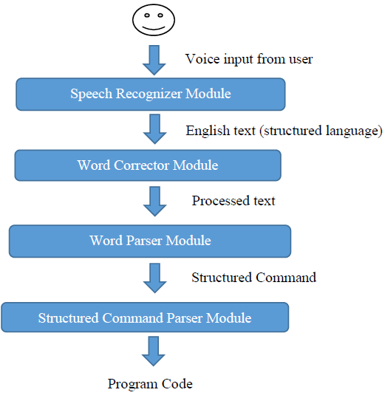
System Architecture

Slide 22
declare float money equal three point two and declare
declare float money equal three point two end declare
#create float #variable money #value 3.2 #dec_end;;
float money = 3.2;

Slide 23
Speech Recognizer module
Converts voice input into English text.
Using python Speech Recognition library
Supports several APIs
Experiment on the APIs

Slide 24
Speech Recognizer module
Experiment with basket of keywords:
Keywords | Google Speech Recognition | Google Cloud Speech API | Microsoft Bing Voice Recognition | Total
Equal | 7 / 10 | 9 / 10 | 6 / 10 | 22 / 30
If Then Else | 5 / 10 | 5 / 10 | 5 / 10 | 15 / 30
End If | 0 / 10 | 5 / 10 | 0 / 10 | 5 / 30
Declare integer | 5 / 10 | 7 / 10 | 0 / 10 | 12 / 30
Size | 6 / 10 | 9 / 10 | 8 / 10 | 23 / 30
Index | 9 / 10 | 10 / 10 | 10 / 10 | 29 / 30
Create Function | 4 / 10 | 9 / 10 | 6 / 10 | 19 / 30
Return Type | 1 / 10 | 8 / 10 | 2 / 10 | 11 / 30
Parameter | 3 / 10 | 9 / 10 | 1 / 10 | 13 / 30
Call | 5 / 10 | 5 / 10 | 10 / 10 | 20 / 30
For | 0 / 10 | 0 / 10 | 0 / 10 | 0 / 30
Plus plus | 5 / 10 | 6 / 10 | 7 / 10 | 18 / 30
While | 0 / 10 | 4 / 10 | 0 / 10 | 4 / 30
Switch case end switch | 0 / 10 | 0 / 10 | 0 / 10 | 0 / 30
Dot | 2 / 10 | 4 / 10 | 0 / 10 | 6 / 30

Slide 25
Speech Recognizer module
Experiment with script for sample program:
 | Google Speech Recognition | Google Cloud Speech API | Microsoft Bing Voice Recognition | Total
Total | 389 / 640 | 423 / 640 | 247 / 640 | 1059 / 1920

Slide 26
Word Corrector module
Process input English text into processed English text.
Because Speech Recognition module is not perfect. (some words misinterpreted)
Phase 1: Correct commonly misinterpreted words
Phase 2: Correct variable names using contextual information.

Slide 27
Word Corrector module
Phase 1
Utilize raw data results from earlier experiments to correct common misinterpretations
Example: End constructs often misinterpreted.
“End function” misinterpreted as “and function”

Slide 28
Word Corrector module
Phase 2
Use contextual information about previously declared variables to do correction.
Variable | makes
Find most similar
Declared Variables
number
length
max

Slide 29

Word Corrector module
Phase 2
Use contextual information about previously declared variables to do correction.
Variable | makes
Declared Variables
number
length
max
Encode(“number”)
Encode(“length”)
Encode(“makes”)
Encode(“max”)
Phonetic Encoding with American Soundex

Slide 30
Word Corrector module
Phase 2
Use contextual information about previously declared variables to do correction.
max
Declared Variables
number
length
max
Variable | makes
0.0
Encode(“number”)
0.5
Encode(“length”)
Encode(“makes”)
Encode(“max”)
0.85
Compare with Jaro-Winkler Distance

Slide 31
Word Corrector module
About jellyfish python library
Many ways of Phonetic encoding
American Soundex
Metaphone
NYSIIS
Many ways of string comparisons
Levenshtein Distance
Damerau-Levenshtein Distance
Hamming Distance
Jaro Distance
Jaro-Winkler Distance

Slide 32
Word Corrector module
Limitations
Heuristic to find closest matching pair of words
Sometimes it can be difficult to tell which words are of closer match
Example: Is “wood” closer to “book”, “loot” or “could”

Slide 33
Word Parser module
Converts processed text into structured command
Using python pyparsing library
Allows parsing with user-defined grammar rules
Allows easy editing of structured language
Context free grammar

Slide 34
Word Parser module
Example: Function Declaration construct
function_declaration_line = keyword_create_function + variable_name + Optional(keyword_with) + keyword_return_type + variable_type + ZeroOrMore(parameter_statement.setResultsName("params", True)) + keyword_begin + ZeroOrMore(statement.setResultsName("stmts", True)) + keyword_end_function
keyword_begin_function

Slide 35
Structured Command Parser module
Converts structured command into program code
Wrapper module
Runs the Java program from previous project
The program able to construct a C program with its Abstracted Syntactical structure.

Slide 36
Product Demo

Slide 37
Plans for next semester
Improving the Structured Language
A little bit difficult to remember
While retaining unambiguous domain
Use keywords recognized more easily

Slide 38
Plans for next semester
Adding more constructs to the Structured Language
Switch statement (switch – case construct)
Logical “and”, logical “or” for comparison statements
Shorthand assignment operators (i.e. += , *= )
Allowing symbols like percentage (%), dollar ($), ampersand (&)
Many more…

Slide 39
Plans for next semester
Improving Word Corrector module
Phase 1 correction currently uses hardcoded algorithm
One possible way: Use word similarity heuristic in Word Corrector module phase 2
Look at the plausibility of such method and find alternative methods if necessary

Slide 40
Plans for next semester
Improving overall program
Develop a GUI
Keeps reading voice input
Program Code | History
int main () { int a; } | create function main return type integer begin declare integer a end declare
Feedback: Unrecognized language: “E clair integer b and declare”
You can start speaking the next line now …
Undo
Export
Cheatsheet

Slide 41
End
Thank you

